Slide 1
Implementation of Relational Operations
courtesy of Joe Hellerstein, Mike Franklin, and etc for some slides.
Jianlin Feng
School of Software
SUN YAT-SEN UNIVERSITY

Slide 2
Introduction
Next topic: QUERY PROCESSING
Some database operations are EXPENSIVE
Huge performance gained by being “smart”
  We’ll see 1,000,000x over naïve approach
Main weapons are:
  clever implementation techniques for operators
  exploiting relational algebra “equivalences”
  using statistics and cost models to choose

Slide 3
Simple SQL Refresher
SELECT <list-of-fields>
FROM <list-of-tables>
WHERE <condition>
SELECT S.name, E.cid
FROM Students S, Enrolled E
WHERE S.sid=E.sid AND E.grade='A'

Slide 4
A Really Bad Query Optimizer
σ_{predicates}
For each Select-From-Where query block
  Create a plan that:
    Forms the cross product
    of the FROM clause
    Applies the WHERE clause
(Then, as needed:
  Apply the GROUP BY clause
  Apply the HAVING clause
  Apply any projections and output expressions
  Apply duplicate elimination and/or ORDER BY)
×
…
_{tables}

Slide 5
Cost-based Query Sub-System
Select *
From Blah B
Where B.blah = blah
Queries
Query Parser
Query Optimizer
Plan Generator
Plan Cost Estimator
Catalog Manager
Schema
Statistics
Query Plan Evaluator

Slide 6
The Query Optimization Game
Goal is to pick a “good” plan
  Good = low expected cost, under cost model
  Degrees of freedom:
    access methods
    physical operators
    operator orders
Roadmap for this topic:
  First: implementing individual operators
  Then: optimizing multiple operators

Slide 7

Relational Operations
We will consider how to implement:
  Selection ( σ ) Select a subset of rows.
  Projection ( π ) Remove unwanted columns.
  Join ( ) Combine two relations.
  Set-difference ( − ) Tuples in reln. 1, but not in reln. 2.
  Union ( ∪ ) Tuples in reln. 1 and in reln. 2.
Q: What about Intersection?

Slide 8
Schema for Examples
Sailors (sid: integer, sname: string, rating: integer, age: real)
Reserves (sid: integer, bid: integer, day: dates, rname: string)
Sailors:
  Each tuple is 50 bytes long, 80 tuples per page, 500 pages.
  [S]=500, p_{S}=80.
Reserves:
  Each tuple is 40 bytes, 100 tuples per page, 1000 pages.
  [R]=1000, p_{R}=100.

Slide 9
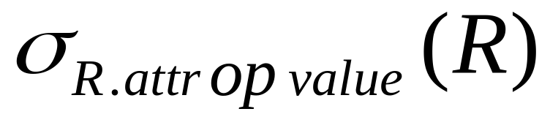
Simple Selections
SELECT *
FROM Reserves R
WHERE R.rname < ‘C%’
How best to perform? Depends on:
  what indexes are available
  expected size of result
Size of result approximated as
(size of R) * selectivity
  selectivity estimated via statistics – we will discuss shortly.
Notes:
11

Slide 10
Our options …
If no appropriate index exists:
  Must scan the whole relation
  cost = [R]. For “reserves” = 1000 I/Os.

Slide 11
Our options …
With index on selection attribute:
  1. Use index to find qualifying data entries
  2. Retrieve corresponding data records
  Total cost = cost of step 1 + cost of step 2
  For “reserves”, if selectivity = 10% (100 pages, 10000 tuples):
    If clustered index, cost is a little over 100 I/Os;
    If unclustered, could be up to 10000 I/Os! … unless …
Index entries
UNCLUSTERED
CLUSTERED
direct search for
data entries
Data entries
Data entries
(Index File)
(Data file)
Data Records
Data Records

Slide 12
Refinement for unclustered indexes
  1. Find qualifying data entries.
  2. Sort the rids of the data records to be retrieved.
  3. Fetch rids in order.
  Each data page is looked at just once (though # of such pages likely to be higher than with clustering).
UNCLUSTERED
Data entries
(Index File)
(Data file)
Data Records

Slide 13
General Selection Conditions
(day<8/9/94 AND rname=‘Paul’) OR bid=5 OR sid=3
First, convert to conjunctive normal form (CNF):
  (day<8/9/94 OR bid=5 OR sid=3 ) AND
  (rname=‘Paul’ OR bid=5 OR sid=3)
We only discuss the case with no ORs
Terminology:
  A B-tree index matches terms that involve only attributes in a prefix of the search key. e.g.:
  Index on <a, b, c> matches a=5 AND b= 3, but not b=3.
Notes:
13

Slide 14
2 Approaches to General Selections
Approach I:
Find the cheapest access path
retrieve tuples using it
Apply any remaining terms that don’t match the index
  Cheapest access path: An index or file scan that we estimate will require the fewest page I/Os.
Notes:
14

Slide 15
Cheapest Access Path - Example
query: day < 8/9/94 AND bid=5 AND sid=3
some options:
B+tree index on day; check bid=5 and sid=3 afterward.
hash index on <bid, sid>; check day<8/9/94 afterward.
How about a B+tree on <rname, day>?
How about a B+tree on <day, rname>?
How about a Hash index on <day, rname>?

Slide 16
2 Approaches to General Selections (Contd.)
Approach II: use 2 or more matching indexes.
1. From each index, get set of rids
2. Compute intersection of rid sets
3. Retrieve records for rids in intersection
4. Apply any remaining terms
  EXAMPLE: day<8/9/94 AND bid=5 AND sid=3
  Suppose we have an index on day, and another index on sid.
  Get rids of records satisfying day<8/9/94.
  Also get rids of records satisfying sid=3.
  Find intersection, then retrieve records, then check bid=5.
Notes:
15

Slide 17
Projection
SELECT DISTINCT
R.sid, R.bid
FROM Reserves R
Issue is removing duplicates.
Use sorting!!
  1. Scan R, extract only the needed attributes
  2. Sort the resulting set
  3. Remove adjacent duplicates
  Cost:
  Ramakrishnan/Gehrke writes to temp table at each step!
  Reserves with size ratio 0.25 = 250 pages.
  With 20 buffer pages can sort in 2 passes, so: 1000 +250 + 2 * 2 * 250 + 250 = 2500 I/Os
Notes:
16

Slide 18
Projection -- improved
Avoid the temp files, work on the fly:
  Modify Pass 0 of sort to eliminate unwanted fields.
  Modify Passes 1+ to eliminate duplicates.
  Cost:
  Reserves with size ratio 0.25 = 250 pages.
  With 20 buffer pages can sort in 2 passes, so:
    Read 1000 pages
    Write 250 (in runs of 40 pages each) = 7 runs
    Read and merge runs (20 buffers, so 1 merge pass!)
  Total cost = 1000 + 250 +250 = 1500.

Slide 19
Other Projection Tricks
If an index search key contains all wanted attributes:
Do index-only scan
  Apply projection techniques to data entries (much smaller!)
If a B+Tree index search key prefix has all wanted attributes:
Do in-order index-only scan
  Just retrieve the data entries in order;
  Discarding unwanted fields;
  Compare adjacent tuples on the fly to check for duplicates.
Notes:
18

Slide 20

Joins
SELECT *
FROM Reserves R1, Sailors S1
WHERE R1.sid=S1.sid
Joins are very common.
R S is large; so, R S followed by a selection is inefficient.
Many approaches to reduce join cost.
Join techniques we will cover today:
  Nested-loops join
  Index-nested loops join
  Sort-merge join

Slide 21
Simple Nested Loops Join
R S:
foreach tuple r in R do
foreach tuple s in S do
if r_{i} == s_{j} then add <r, s> to result
Cost = (p_{R}*[R])*[S] + [R] = 100*1000*500 + 1000 IOs
  At 10ms/IO, Total time: ???
What if smaller relation (S) was “outer”?
What assumptions are being made here?
What is cost if one relation can fit entirely in memory?

Slide 22
Page-Oriented Nested Loops Join
R S:
foreach page b_{R} in R do
foreach page b_{S} in S do
foreach tuple r in b_{R} do
foreach tuple s in b_{S}do
if r_{i} == s_{j} then add <r, s> to result
Cost = [R]*[S] + [R] = 1000*500 + 1000
If smaller relation (S) is outer, cost = 500*1000 + 500
Much better than naïve per-tuple approach!

Slide 23
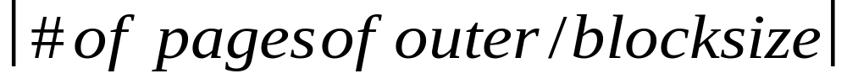
Block Nested Loops Join
Page-oriented NL doesn’t exploit extra buffers :(
Idea to use memory efficiently:
R & S
Join Result
block of R tuples
(B-2 pages)
. . .
. . .
. . .
Input buffer for S
Output buffer
Cost: Scan outer + (#outer blocks * scan inner)
  #outer blocks =

Slide 24
Examples of Block Nested Loops Join
Say we have B = 100+2 memory buffers
Join cost = [outer] + (#outer blocks * [inner])
  #outer blocks = [outer] / 100
With R as outer ([R] = 1000):
  Scanning R costs 1000 IO’s (done in 10 blocks)
  Per block of R, we scan S; costs 10*500 I/Os
  Total = 1000 + 10*500.
With S as outer ([S] = 500):
  Scanning S costs 500 IO’s (done in 5 blocks)
  Per block of S, we can R; costs 5*1000 IO’s
  Total = 500 + 5*1000.

Slide 25
Index Nested Loops Join
R S:
foreach tuple r in R do
foreach tuple s in S where r_{i} == s_{j} do
add <r, s> to result
lookup(r_{i})
R:
r_{i}
INDEX on S
Data entries
S:
s_{j}
Data Records

Slide 26
Index Nested Loops Join
R S:
foreach tuple r in R do
foreach tuple s in S where r_{i} == s_{j} do
add <r, s> to result
Cost = [R] + ([R]*p_{R}) * cost to find matching S tuples
  If index uses Alt. 1, cost = cost to traverse tree from root to leaf.
  For Alt. 2 or 3:
    Cost to lookup RID(s); typically 2-4 IO’s for B+Tree.
    Cost to retrieve records from RID(s); depends on clustering.
      Clustered index: 1 I/O per page of matching S tuples.
      Unclustered: up to 1 I/O per matching S tuple.

Slide 27
Reminder: Schema for Examples
Sailors (sid: integer, sname: string, rating: integer, age: real)
Reserves (sid: integer, bid: integer, day: dates, rname: string)
Sailors:
  Each tuple is 50 bytes long, 80 tuples per page, 500 pages.
  [S]=500, p_{S}=80.
Reserves:
  Each tuple is 40 bytes, 100 tuples per page, 1000 pages.
  [R]=1000, p_{R}=100.

Slide 28
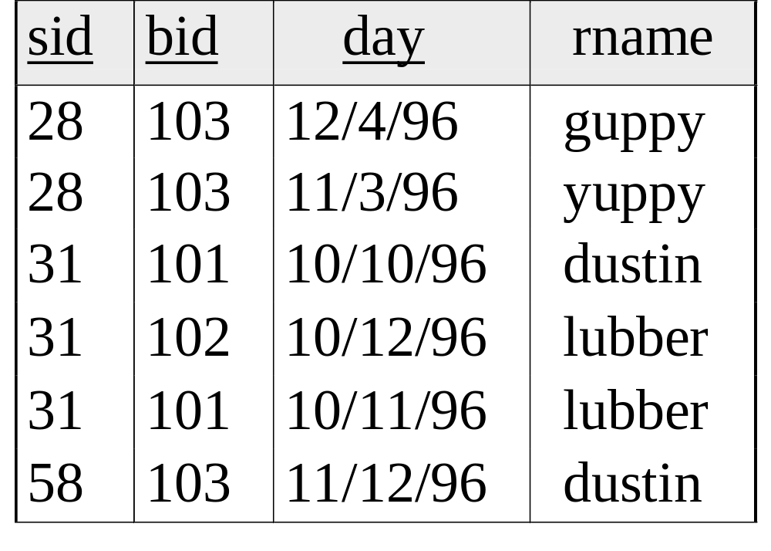
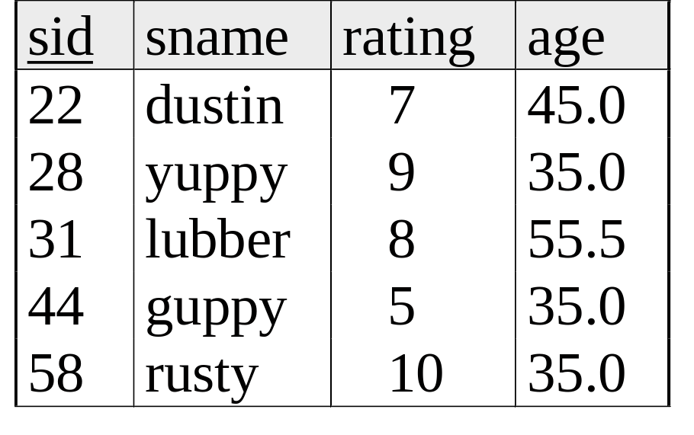
Sort-Merge Join
  Sort R on join attr(s)
  Sort S on join attr(s)
  Scan sorted-R and sorted-S in tandem, to find matches
Example:
SELECT *
FROM Reserves R1, Sailors S1
WHERE R1.sid=S1.sid

Slide 29
Cost of Sort-Merge Join
Cost: Sort R + Sort S + ([R]+[S])
  But in worst case, last term could be [R]*[S] (very unlikely!)
  Q: what is worst case?
Suppose B = 35 buffer pages:
Both R and S can be sorted in 2 passes
Total join cost = 4*1000 + 4*500 + (1000 + 500) = 7500
Suppose B = 300 buffer pages:
Again, both R and S sorted in 2 passes
Total join cost = 7500
Block-Nested-Loop cost = 2500 … 15,000

Slide 30

Refinement of Sort-Merge Join
We can combine the merging phases in the sorting of R and S with the merging required for the join.
  If B > , where L is the size of the larger relation,
  using the sorting refinement (13.3.1) that produces runs of length 2B in Pass 0, #runs of each relation is < B/2.
  In “Merge” phase: Allocate 1 page per run of each relation, and `merge’ while checking the join condition
  Cost: read+write each relation in Pass 0 + read each relation in (only) merging pass (+ writing of result tuples).
  In example, cost goes down from 7500 to 4500 I/Os.

Slide 31
Hash-Join
Original
Relation
OUTPUT
Partitions
1
1
INPUT
2
Partition both relations on the join attributes using hash function h.
R tuples in partition R_{i} will only match S tuples in partition S_{i}.
2
. . .
hash
function
h
B-1
B-1
Disk
B main memory buffers
Disk
Partitions
of R & S
For i= 1 to #partitions {
  Read in partition R_{i}
  and hash it using h2 (not h).
  Scan partition S_{i} and probe hash table for matches.
  }
Join Result
Hash table for partition
Ri (k < B-1 pages)
hash
fn
h2
h2
Input buffer
for Si
Output
buffer
Disk
B main memory buffers
Disk

Slide 32

Memory Requirements of Hash-Join
#partitions k < B, and B-1 > size of largest partition to be held in memory. Assuming uniformly sized partitions, and maximizing k, we get:
  k= B-1, and M/(B-1) < B-2, i.e., B must be >
Since we build an in-memory hash table to speed up the matching of tuples in the second phase, a little more memory is needed.
If the hash function does not partition uniformly, one or more R partitions may not fit in memory.
  Can apply hash-join technique recursively to do the join of this R-partition with corresponding S-partition.

Slide 33
Cost of Hash-Join
In partitioning phase, read+write both relns; 2(M+N). In matching phase, read both relns; M+N I/Os.
In our running example, this is a total of 4500 I/Os.
Sort-Merge Join vs. Hash Join:
  Given a minimum amount of memory (what is this, for each?) both have a cost of 3(M+N) I/Os. Hash Join superior if relation sizes differ greatly (e.g., if one reln fits in memory). Also, Hash Join shown to be highly parallelizable.
  Sort-Merge less sensitive to data skew; result is sorted.

Slide 34
Set Operations
Intersection and cross-product as special cases of join.
Union (Distinct) and Except similar; we’ll do union.
Sorting based approach to union:
  Sort both relations (on combination of all attributes).
  Scan sorted relations and merge them.
  Alternative: Merge runs from Pass 0 for both relations.
Hash based approach to union:
  Partition R and S using hash function h.
  For each S-partition, build in-memory hash table (using h2), scan corresponding R-partition and add tuples to table while discarding duplicates.
Notes:
19

Slide 35
General Join Conditions
Equalities over several attributes (e.g., R.sid=S.sid AND R.rname=S.sname):
  For Index NL, build index on <sid, sname> (if S is inner); or use existing indexes on sid or sname.
  For Sort-Merge and Hash Join, sort/partition on combination of the two join columns.
Inequality conditions (e.g., R.rname < S.sname):
  For Index NL, need (clustered!) B+ tree index.
    Range probes on inner; # matches likely to be much higher than for equality joins.
  Hash Join, Sort Merge Join not applicable!
  Block NL quite likely to be the best join method here.

Slide 36
Aggregate Operations (AVG, MIN, etc.)
Example:
SELECT AVG(S.age)
FROM Sailors S
Without grouping:
  In general, requires scanning the relation.
  Given a tree index whose search key includes all attributes in the SELECT or WHERE clauses, can do index-only scan.
Notes:
20

Slide 37
Aggregate Operations (continued)
With grouping:
  Sort on group-by attributes, then scan relation and compute aggregate for each group. (Better: combine sorting and aggregate computation.)
  Similar approach based on hashing on group-by attributes.
  Given a tree index whose search key includes all attributes in SELECT, WHERE and GROUP BY clauses, can do index-only scan;
    if group-by attributes form prefix of search key, can retrieve data entries/tuples in group-by order.
Notes:
20

Slide 38
Summary
Queries are composed of a few basic operators;
  The implementation of these operators can be carefully tuned (and it is important to do this!).
Many alternative implementation techniques for each operator; no universally superior technique for most.
Must consider alternatives for each operation in a query and choose best one based on statistics, etc.
This is part of the broader task of Query Optimization, which we will cover next!
Notes:
22

